Slide 1
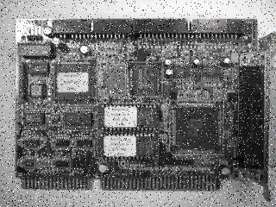
Image Processing
鄭皓中
P76081116

Slide 2
Outline
RGB Extraction & transformation
Smooth filter (mean and median)
Histogram Equalization
A user-defined thresholding
Sobel edge detection
Edge overlapping
Image rotation, stretching in both horizontal and vertical Direction
Discussion and Conclusion

Slide 3
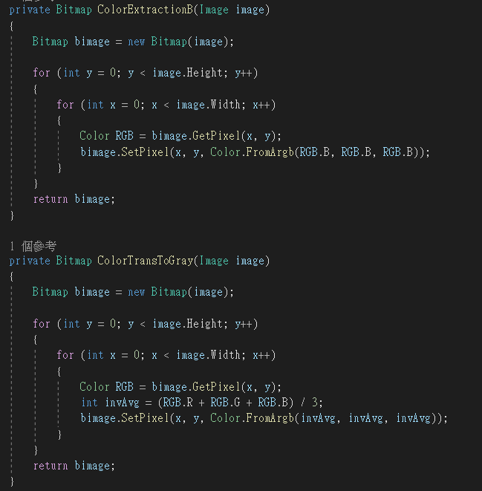
RGB Extraction & Transformation (1/2)
Method

Slide 4
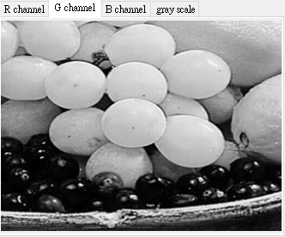
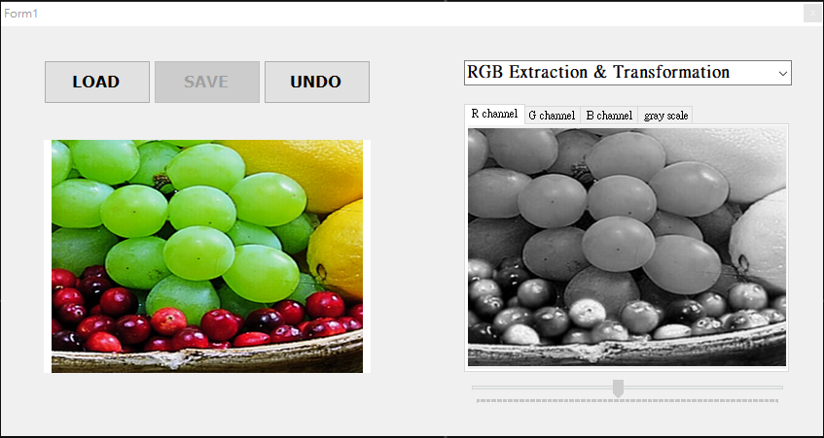
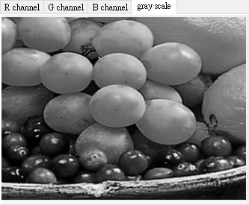
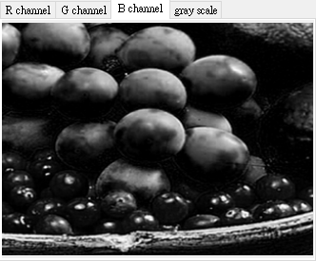
RGB Extraction & Transformation (2/2)
Result

Slide 5
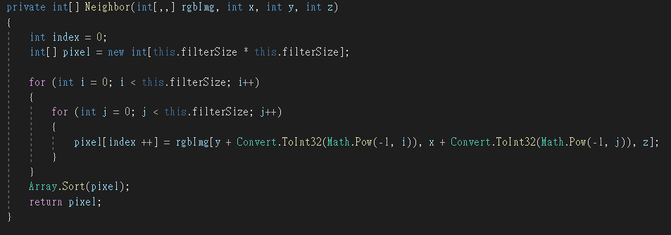
Smooth filter (1/3)
Method
Filter size : 3 * 3

Slide 6
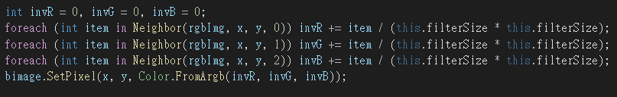
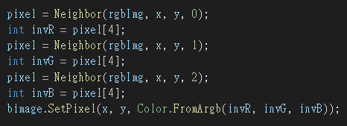
Smooth filter (2/3)
Method
Mean
Median

Slide 7
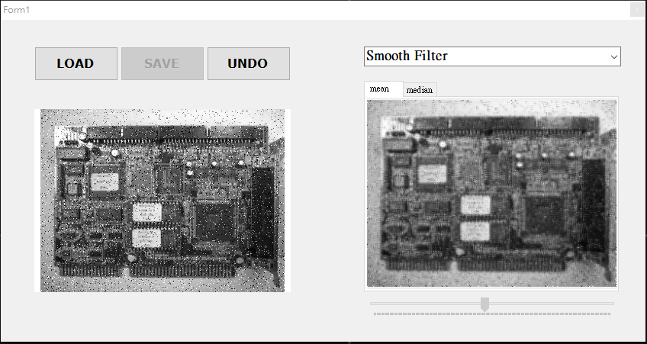
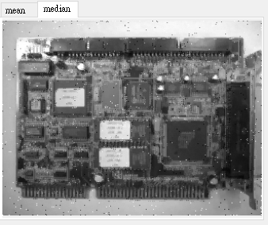
Smooth filter (3/3)
Result

Slide 8
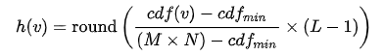
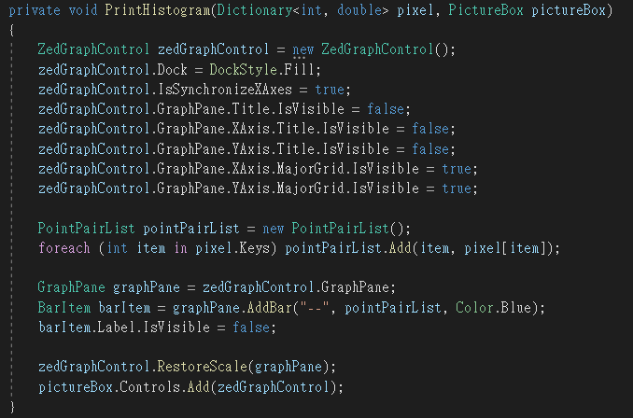
Histogram Equalization (1/3)
Method
PDF → CDF → Equalization
Histogram : Zedgraph

Slide 9
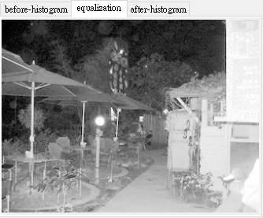
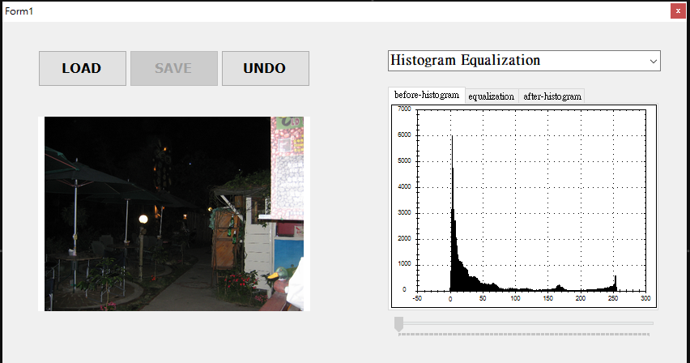
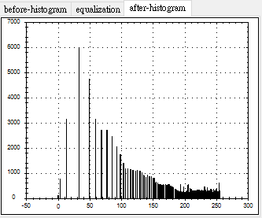
Histogram Equalization (2/3)
Result

Slide 10
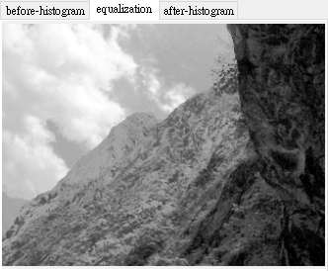
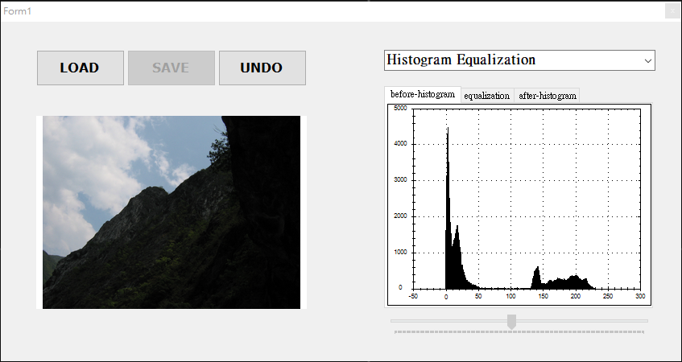
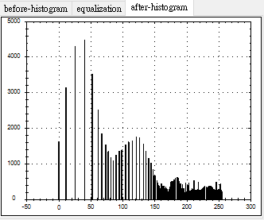
Histogram Equalization (3/3)
Result

Slide 11
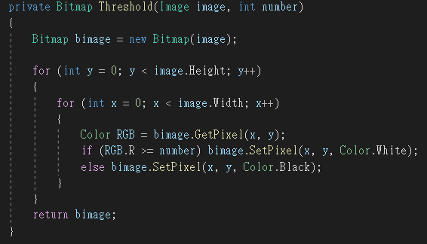
A User-defined Thresholding (1/2)
Method

Slide 12
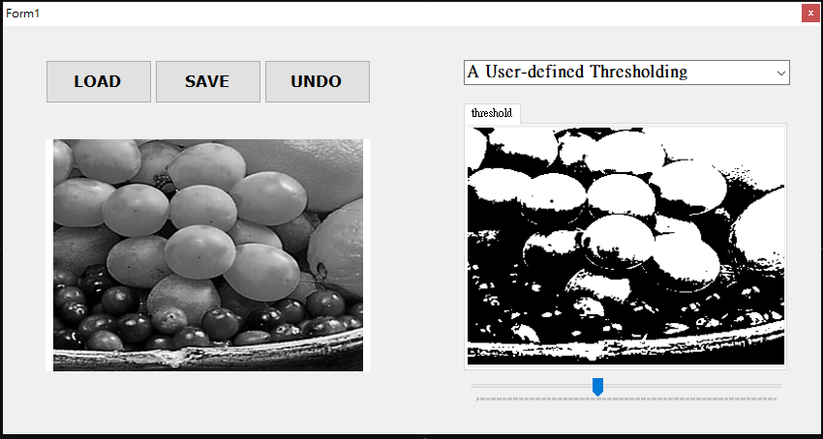
A User-defined Thresholding (2/2)
Result

Slide 13
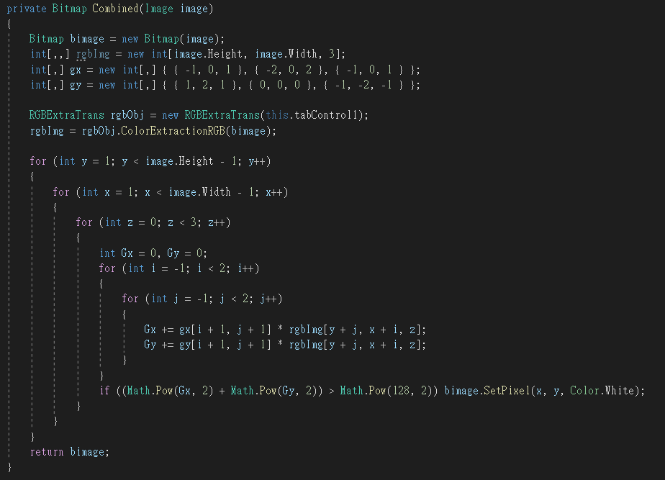
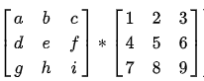
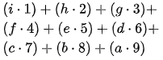
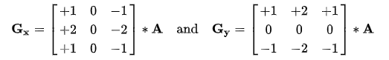
Sobel Edge Detection (1/2)
Method
Sobel operator
G > 128 or G > 128*128
https://zh.wikipedia.org/zh-tw/%E7%B4%A2%E8%B2%9D%E7%88%BE%E7%AE%97%E5%AD%90

Slide 14
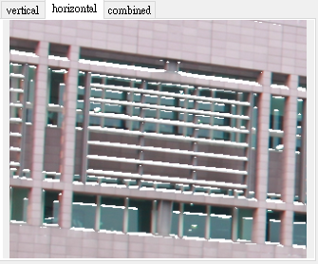
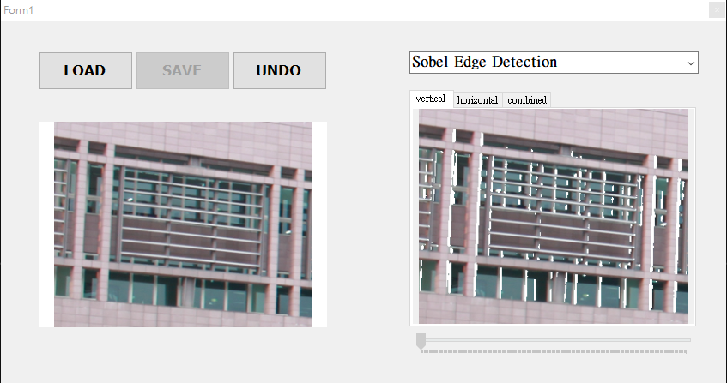
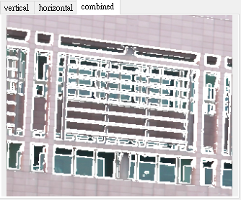
Sobel Edge Detection (2/2)
Result

Slide 15
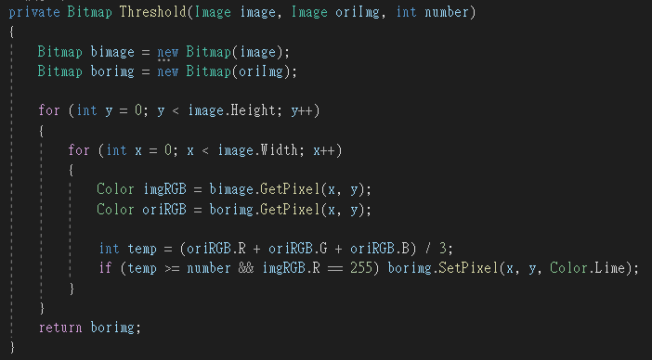
Edge Overlapping (1/2)
Method

Slide 16
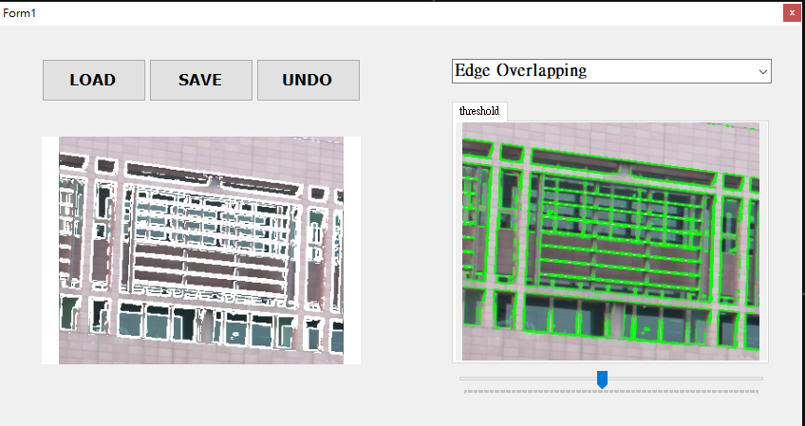
Edge Overlapping (2/2)
Result

Slide 17
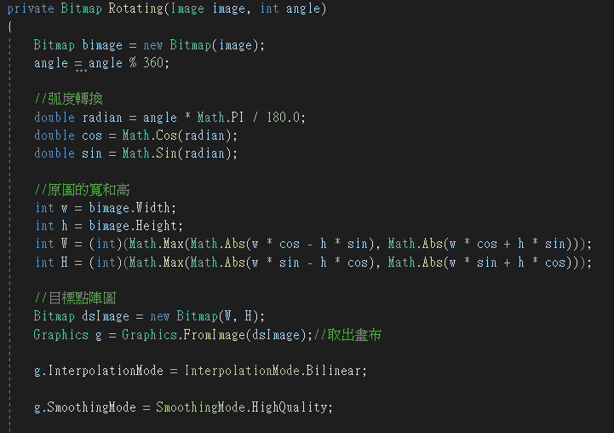
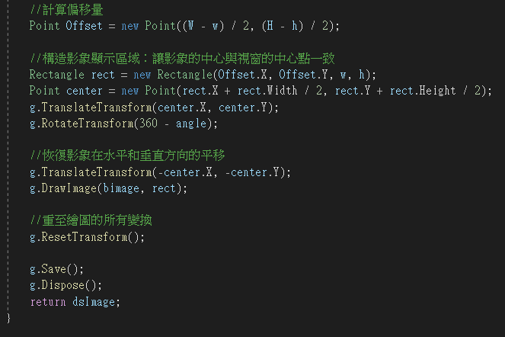
Image rotation, stretching in both horizontal and vertical Direction (1/6)
Method : rotation

Slide 18
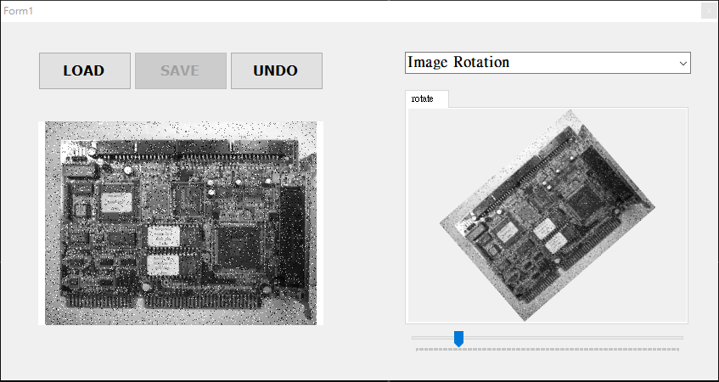
Image rotation, stretching in both horizontal and vertical Direction (2/6)
Result

Slide 19
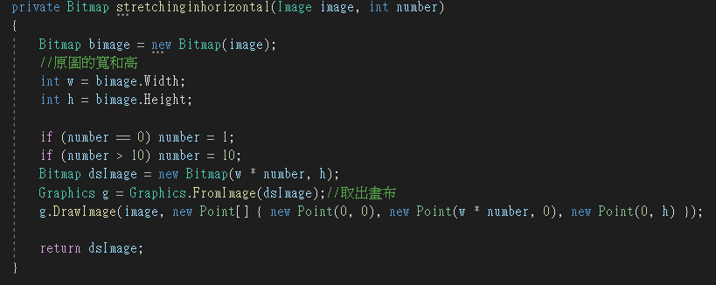
Image rotation, stretching in both horizontal and vertical Direction (3/6)
Method : stretching in horizontal direction

Slide 20
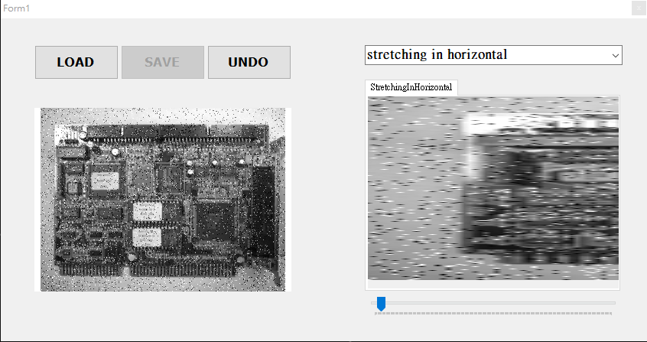
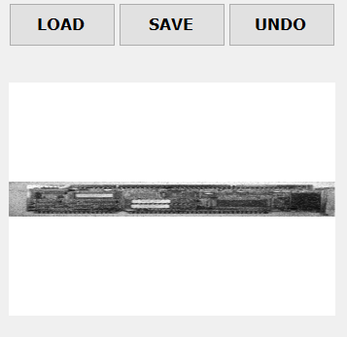
Image rotation, stretching in both horizontal and vertical Direction (4/6)
Result

Slide 21
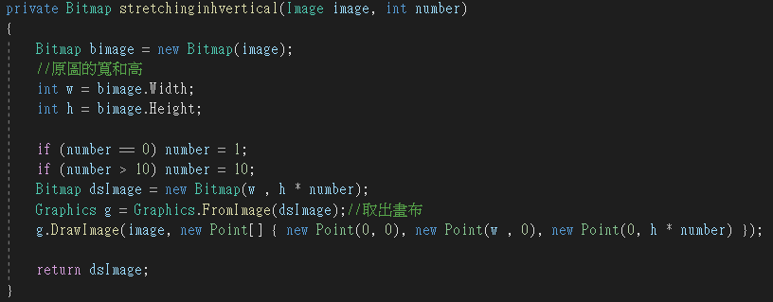
Image rotation, stretching in both horizontal and vertical Direction (5/6)
Method : stretching in vertical direction

Slide 22
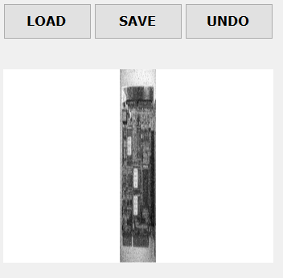
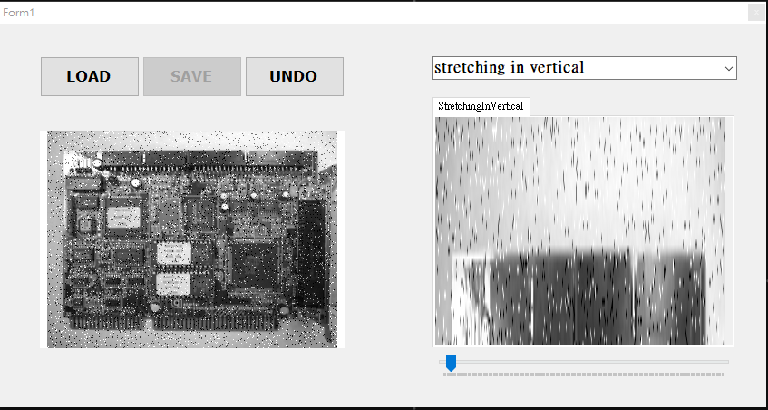
Image rotation, stretching in both horizontal and vertical Direction (6/6)
Result

Slide 23
Discussion and Conclusion
我學會了如何實際去對一張圖片進行影像處理。
也學會了如何發現問題、尋求幫助以解決問題、
利用google學習相關知識、以及統整過程做成ppt。

Slide 24
Thank you for listening

